Slide 1
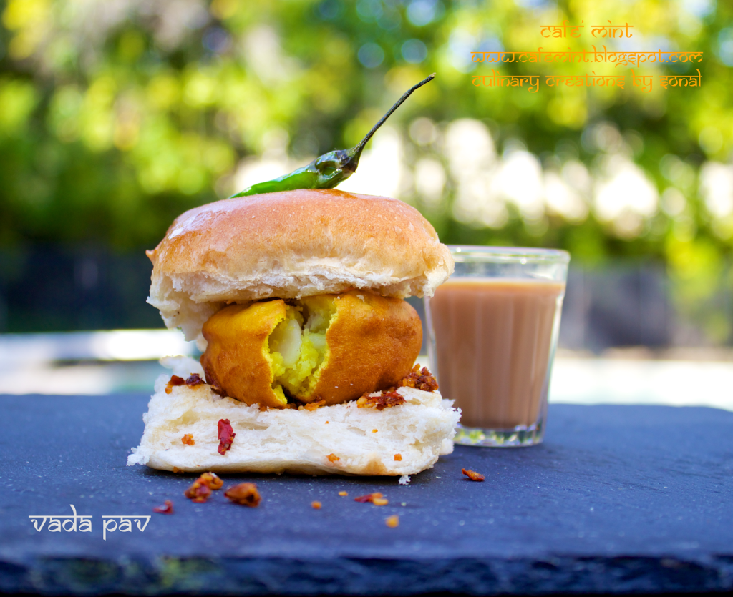
TO START A WADA PAV FOOD RESTAURANT

Slide 2
Agenda
Introduction
Problem statement and data source
Objective & Methodology
Solution and description
Impact

Slide 3
Introduction
A man wants to open a Wada Pav Shop near Shivaji Nagar in Pune. He has got a location where there are other 4 more Wada pav shops. He is not able to understand what will be the strategy to take over his clients .
I have analyzed the data and came with some good insights that will help him to start his Wada pav restaurant at Shivaji nagar Pune .

Slide 4
Problem statement and data source
A man wants to open a Wada Pav Shop near Shivaji Nagar in Pune. He has got a location where there are other 4 more Wada pav shops. He is not able to understand what will be the strategy to take over his clients .
I have noted the reviews of customers on Google to know the needs of customers and best things offered by our competitors and came out with some good insights that will help us to beat the competitors.

Slide 5


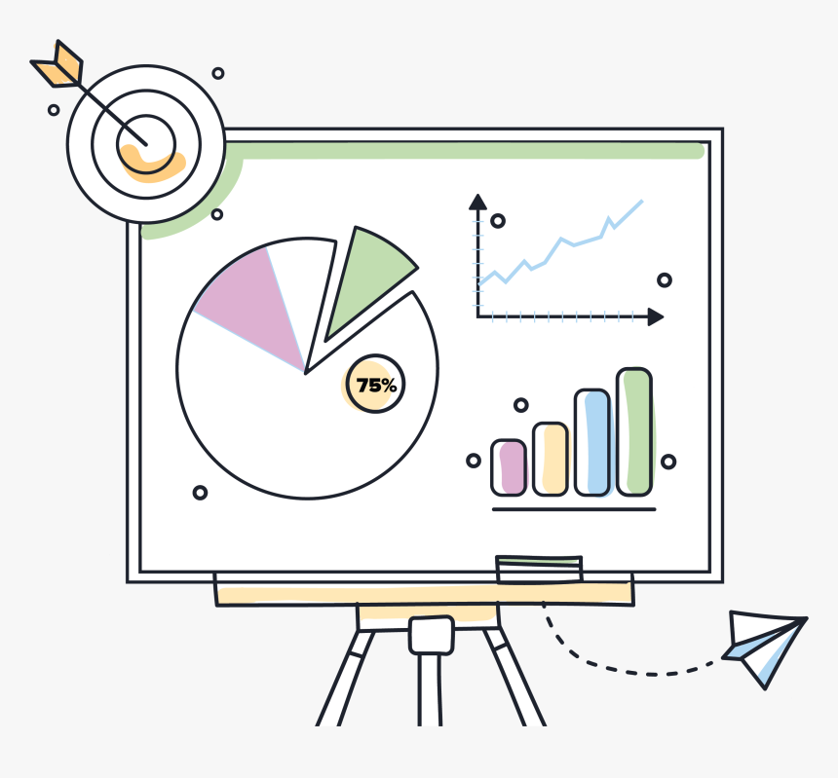
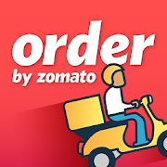
Objective & Methodology
To Know the pros and cons od vada pav restaurant before setup .
To know the food trends in that particular area .
To know the like and dislikes of competitor restaurants .
Data collection
Data processing
Visualizing

Slide 6
Solution Description
Pricing is the first marketing skill we have to keep the price affordable to the mass customers. The average of four competitors Wada pav price is Twenty rupees and it is to be our price because it is catchy and affordable.
• The restaurant should be spacious for seating and parking and properly maintained for good hygiene and good
ambience.
• The Vada pav should not be Oily and should concentrate on the quality of food.
• Staff should be polite and service should be fast in order to do fast service we should recruit more staff
according to the inflow customers.
• The next insight we came across is the variety of food. The most common varieties that people like among the four competitors and that are the bestselling in the market. The four varieties are;
1. Misal Pav
2. Cold coffee with ice cream
3. Mango lassi
4. Wada Pav with tea
• The Last insight we should always consider is the taste of food and customer service.

Slide 7
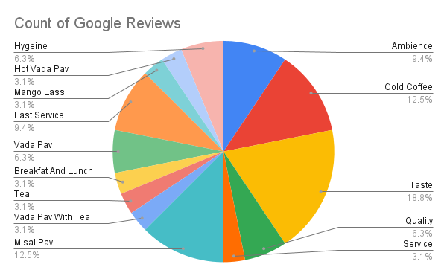
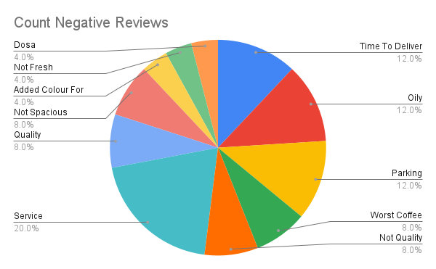
Visualization

Slide 8
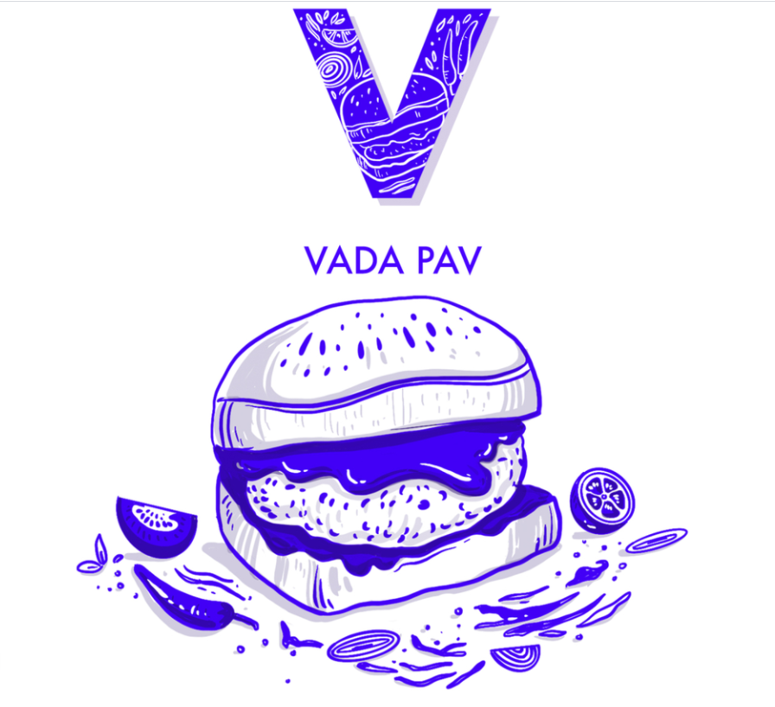
Thank You
Namala
enkatesh

